Slide 1
SUPERVISED ML CLASSFICATION CAPSTONE PROJECT
PREDICTING SENTIMENT OF COVID-19 TWEETS

Slide 2

Contents
Problem Statement
Data Inspection
Data Analysis
Removing Punctuations
Removing Stop words
Removing Hashtags
Count Vectorizer
Implementing Algorithms
Conclusion

Slide 3
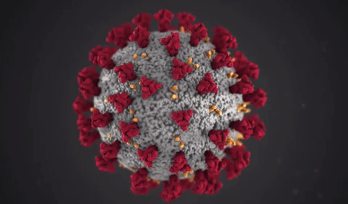
Introduction:
The respiratory infections caused by human respiratory viruses are among the most prevalent viral illnesses that affect people (RVs) The influenza virus, also known as the "flu," is the most well-known type of respiratory viral infection and accounts for between 250,000 and 500,000 fatalities annually globally. The H1N1 virus is its most well-known variety. The corona virus is one of the virus families that cause respiratory illnesses. It infects the epithelial cells of the respiratory tract in humans, frequently going undetected but occasionally being fatal. The Middle East Respiratory Syndrome (MERS), Severe Acute Respiratory Syndrome (SARS), and currently Corona virus Disease are the most well-known corona virus varieties (COVID-19)..

Slide 4

Problem Statement:
The pandemic illnesses that are currently plaguing the world, in particular, pose major issues for the population on all fronts: economic, emotional, status, planning, and politics, in addition to the complexity of customs, ethics, personal psychology, and interpersonal behaviours. Therefore, when difficult situations happen, it is essential and required to analyse people's views. Observing how people respond to this threat can reveal crucial details about how society behaves and responds to unforeseen events, whether positively or negatively. At the moment, the internet and social media have evolved into potent tools for gathering people's opinions and comments on a variety of subjects. The major goal is to create a prediction model that could aid in anticipating a tweet's sentiment.

Slide 5
Data Analysis Steps:
Imported Libraries
In this part, we imported the required libraries NumPy, Pandas, matplotlib, and seaborn, to perform Exploratory Data Analysis and for prediction, we imported the Scikit learn library.
Descriptive Statistics
In this part, we start by looking at descriptive statistic parameters for the dataset. We will use describe() this told mean, median, standard deviation
Missing Value Imputation
We will now check for missing values in our dataset. after checking not existed any missing values, In case there are any missing entries, we will impute them with appropriate values.
Graphical Representation
We will start with Univariate Analysis, bivariate Analysis and conclude with various prediction models helps us predict the Risk.

Slide 6
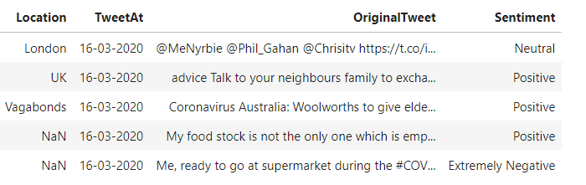
Attribute Information
Location - location of country
Tweet At – timestamp of tweets
Original Tweet – textual content of tweets
Label – Sentiment of the tweets

Slide 7
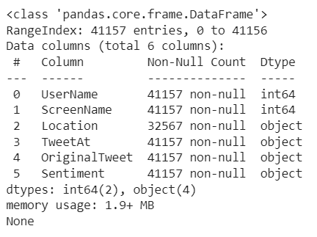
Data Inspection:
This Dataset has contains 41157 rows and 6 columns.
Location - location of country
Tweet At – timestamp of tweets
Original Tweet – textual content of tweets
Label – Sentiment of the tweets

Slide 8
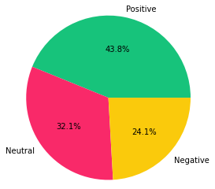
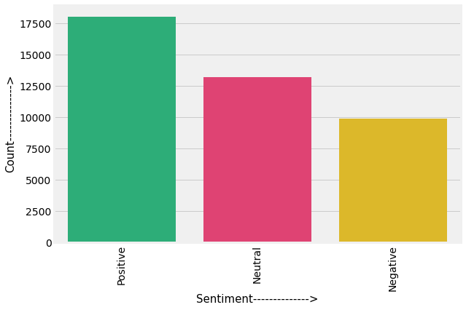
Sentiment Analysis
Sentiment analysis (or opinion mining) is a natural language processing (NLP) technique used to determine whether data is positive, negative or neutral. Sentiment analysis is often performed on textual data to help businesses monitor brand and product sentiment in customer feedback, and understand customer needs.

Slide 9
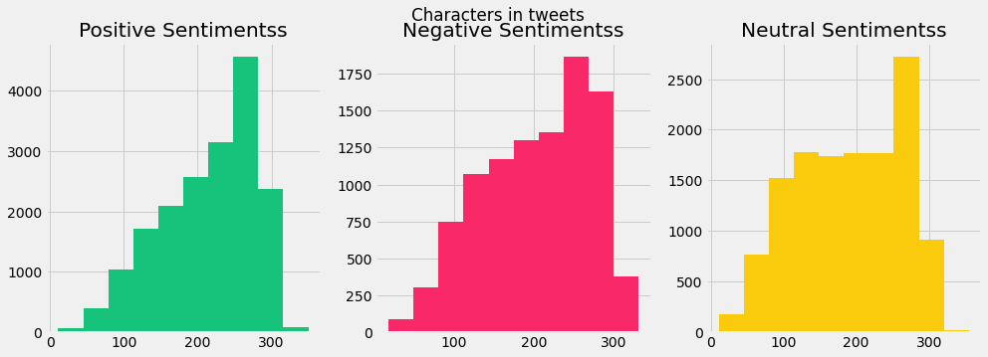
Number of characters in a Tweet
As we can see the number of character used in positive sentiments is between 400-4000.on the other hand for negative sentiments its between 250-1750 and for neutral sentiments its between 200-2500

Slide 10
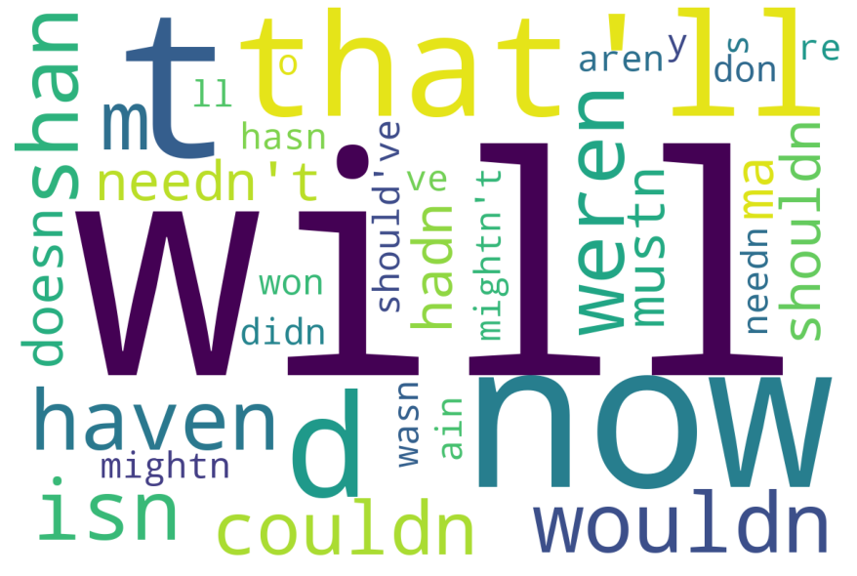
Common Stop words in the tweets
Here we plot word cloud that shows the common stop words that a person used in a tweet whether its positive, negative or neutral sentiments.

Slide 11
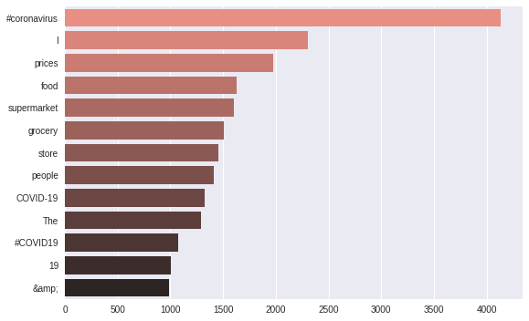
Common Stopwords in the tweets
Here we use bar plot that shows the common words that a person used in a tweet whether its positive, negative or neutral sentiments.

Slide 12
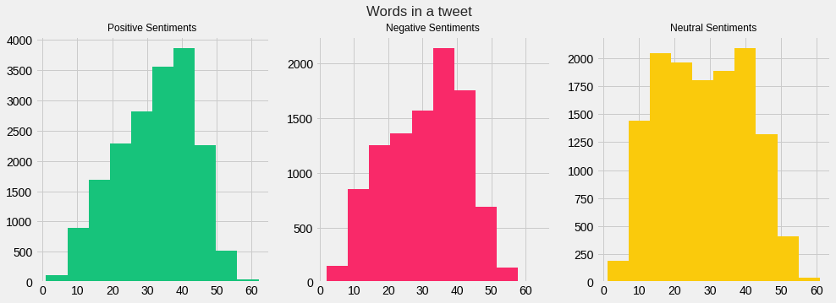
Number of words in a Tweet
As we can see the number of words used in positive sentiments is between 100-3800.on the other hand for negative sentiments its between 100-2100 and for neutral sentiments its between 200-2000.

Slide 13
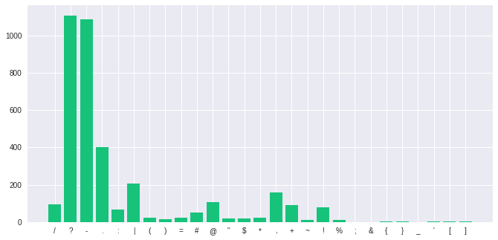
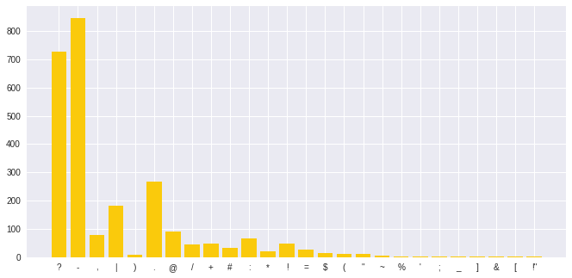
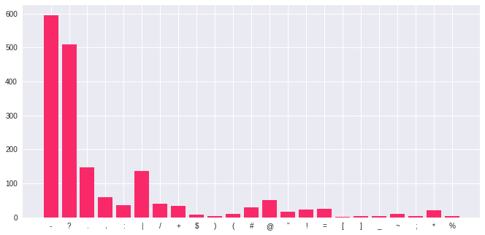
Number of Punctuations
Punctuations used by a person in a tweet.
Green color histogram represent positive sentiments punctuations.
Pink color histogram represent Negative sentiments punctuations.
Yellow color histogram represent Neutral sentiments punctuations.

Slide 14
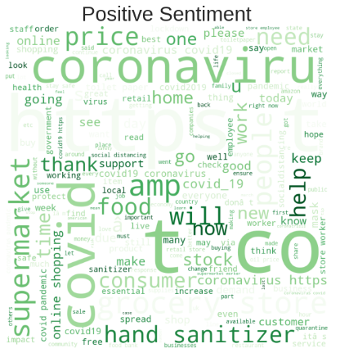
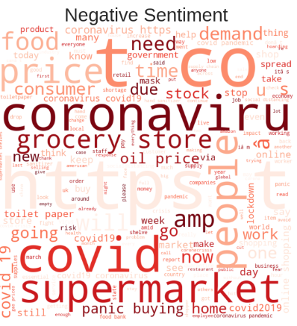
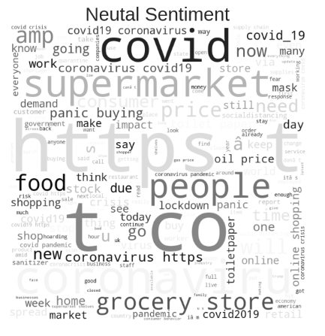
Mentions used in a Tweet

Slide 15
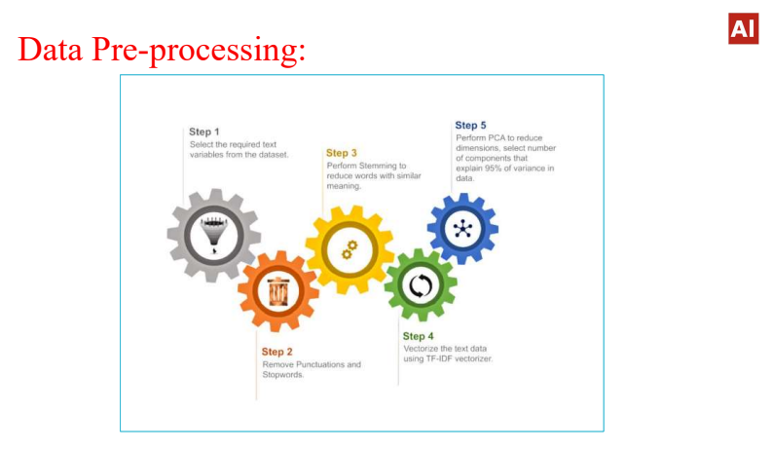

Slide 16
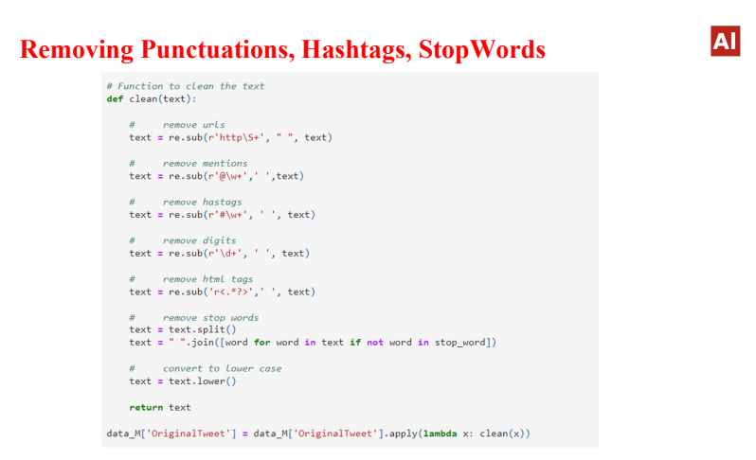

Slide 17
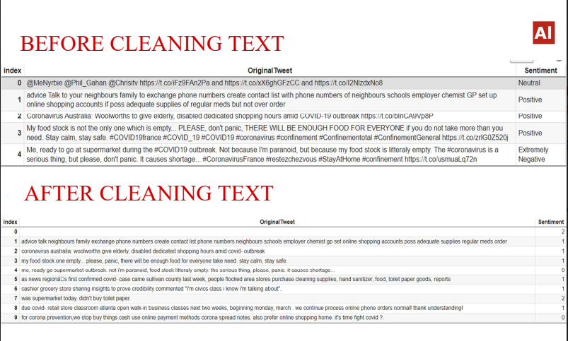

Slide 18
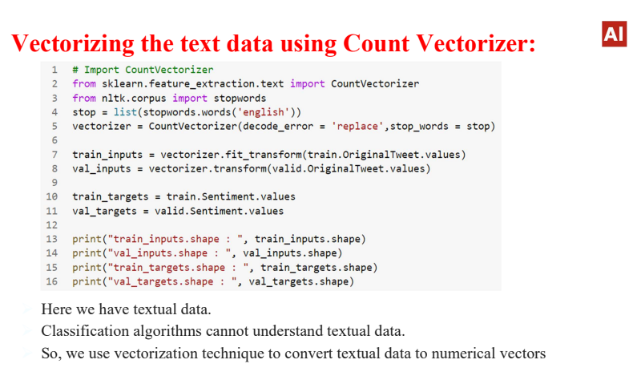

Slide 19
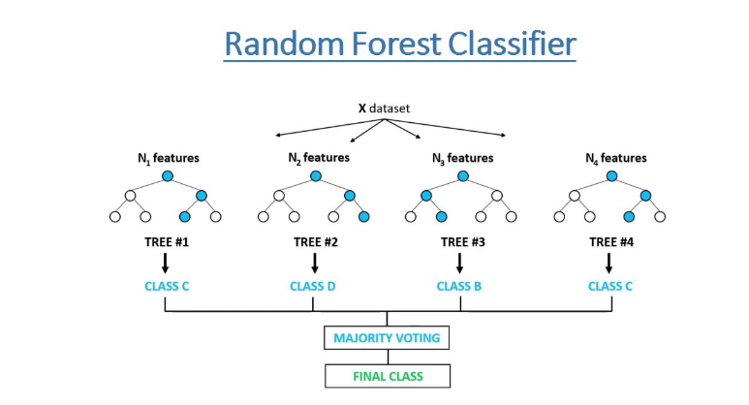
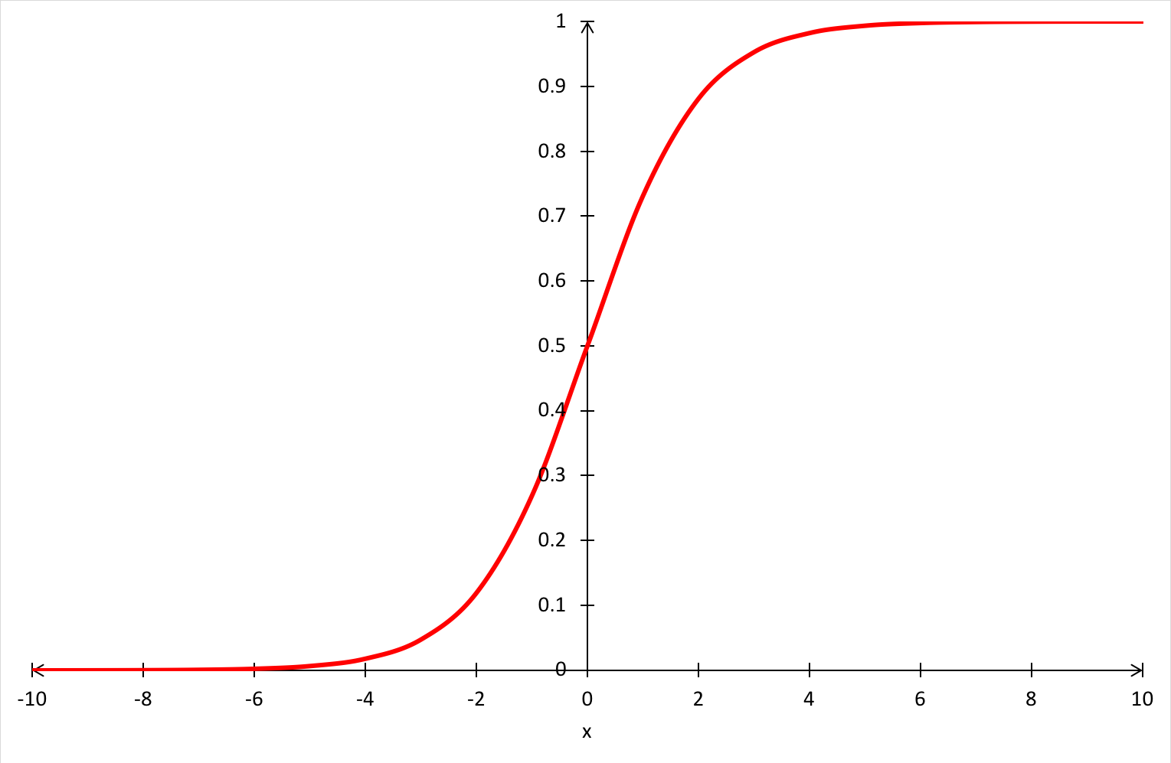
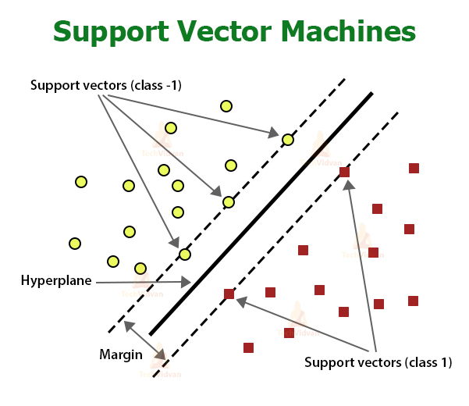
Model Building:
Logistic Regression

Slide 20
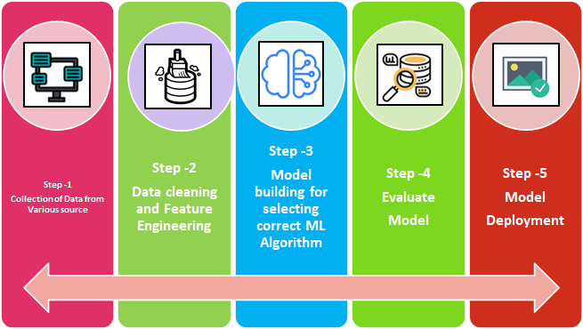
Machine Learning Process Flow:

Slide 21
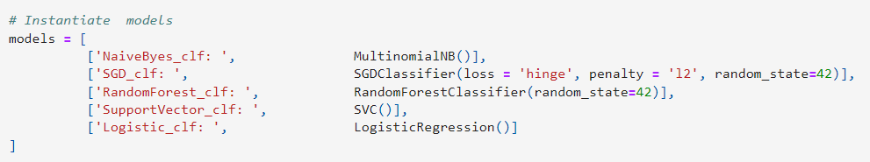
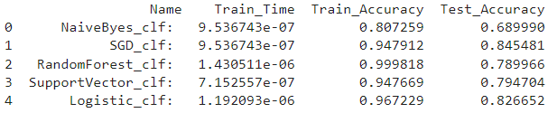
Comparing different Models for Multiclass Classification
In the above Models Evaluation Table(Testing set) our accuracy score is less than 0.80 except Logistic Classifier and Stochastic gradient descent classifier.So we can say that our model predicted the classes in a good manner.
SGD Classifier is performing well which has best Recall,Precision,F1-Score and Accuracy Score.

Slide 22
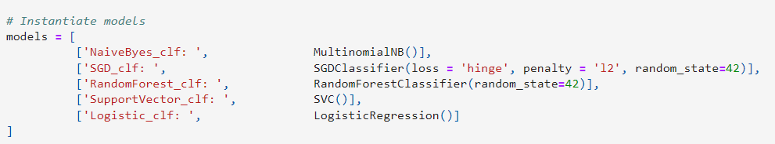
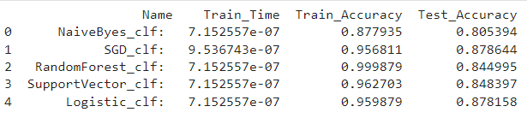
Comparing different Models for Binary Classification
In the above Models Evaluation Table(Testing set) our accuracy score is more than 0.80 except Logistic Classifier and Stochastic gradient descent classifier.So we can say that our model predicted the classes in a good manner.
Logistic Regression Classifier is performing well which has best Recall,Precision,F1-Score and Accuracy Score.

Slide 23
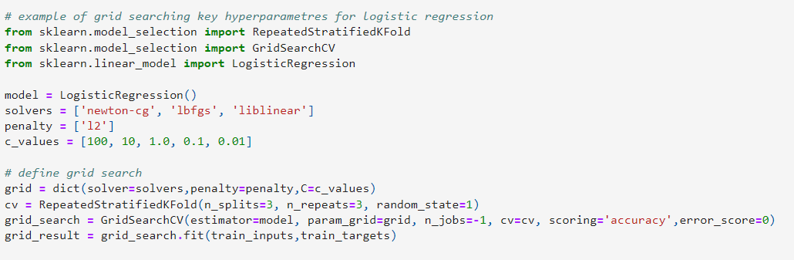
Hyperparameter tuning for logistic regression classifier
In the above hyperparameter tunning we used grid search cv to find the best parameters to train our logistic regression classifier

Slide 24
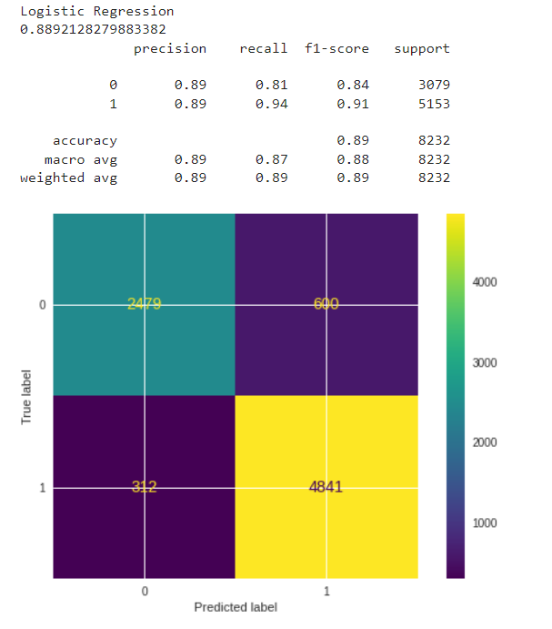
Performance metrics for Logistic classifier
Here 0 represent Negative Sentiments wherease 1 represent Positive Sentiments and Neutral Sentiments.
Model Accuracy score is 89%

Slide 25
Conclusion
This model focuses on analyzing how individuals are responding to the pandemic, taking into account that the COVID-19 disease is a global health issue that has impacted most countries' economies. The model's major objective is to determine, using machine learning algorithms and NLP approaches, if the public's sentiment is favorable or negative. Although the analysis discovered a variety of opinions, it appears that people generally continue to have a positive attitude toward the pandemic. The only month in which negative thoughts predominated was January, and the month in which the COVID-19 disease was declared a pandemic and many countries began to implement care measures and safety protocols is March, which also happens to be the month in which positive thoughts began to increase.

Slide 26


